Slide 1
PRESENT perfect SIMPLE /PRESENT perfect CONTINUOUS
Caterina Ines Latella

Slide 2
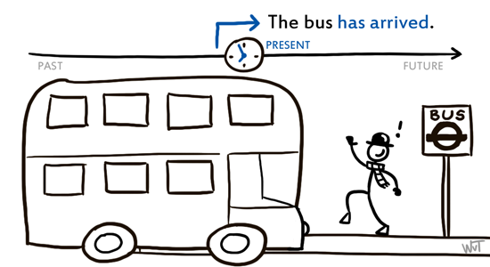
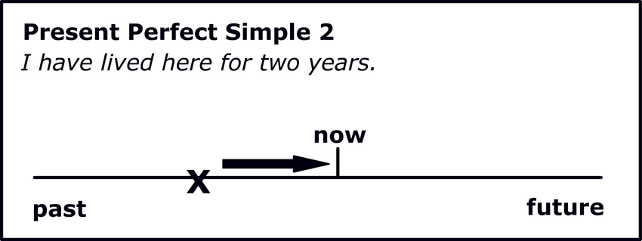
PRESENT perfect SIMPLE
We use the Present Perfect Simple to talk about actions that began in the past and are still continuing in the present, or actions which were completed in the past, but are still connected to the present.

Slide 3
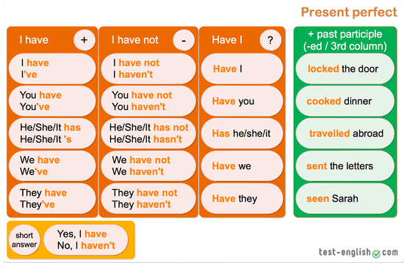
PRESENT perfect SIMPLE FORM

Slide 4
MORE EXAMPLES
Affirmative: I have been ill for 10 days
Negative : Mark hasn’t been at work for 10 days
Interrogative: Have you been ill?
Short answers:
- Yes, I have.
- No, I haven’t.

Slide 5

PRACTICE
Ask questions in the present perfect using the following verb phrases
Ex. have a cold (recently) > Have you had a cold recently?
- take medication (lately) > Have you taken medication lately?
- have a routine checkup (recently)
- take someone’s temperature
- catch the flu
- have a headache
- rest enough
- see a doctor
- speak to a nurse

Slide 6
We use the present perfect ….
To talk about EXPERIENCES in life (so far, up to now)
Ex. I’ve been to Berlin** / I’ve travelled by plane twice
- To talk about FINISHED ACTIONS but with NO time reference
Ex. I’ve seen this film
but “I saw this film yesterday” (we use the past simple here)
** Be careful to the preposition after the verb:
Mark has been to Mexico (gone and come back)
Mark has gone to Mexico (he is still there)

Slide 7
how long…….? + (for/since)
To talk about the duration of an action, but with non-action verbs (except ‘work’, ‘live’)
Examples
How long have you had your car?
I’ve had my car FOR 10 years (= desde hace)
I’ve had my car SINCE 2012 (= desde)
Or
I’ve worked here for 5 years

Slide 8
HAVE YOU EVER…….?
To ASK about something that happened in life
Ex. Have you ever + past participle -….
Have you EVER travelled by helicopter?
Yes, I have / No, I haven’t
…..seen a solar eclipse?
…..been to the desert?
Be careful to the preposition after the verb:
Mark has been to Mexico (gone and come back)
Mark has gone to Mexico (he is still there)

Slide 9




just/already/YET
JUST / ALREADY (affirmative sentences)
  Ex. I’ve just had a coffee (Acabo de tomarme un café)
Ex. I’ve already had a coffee (Ya me he tomado un café)
YET (questions and negative sentences)
Ex. Have you had a coffee yet? (¿Todavía/aún no has tomado un café?)
I haven’t had a coffee yet (Aún/Todavía no me he tomado el café)

Slide 10
PRESENT perfect continuous
We use the Present Perfect Continuous to show that an action that began in the past is still continuing (llevar haciendo algo…).
Examples:
- She has been sleeping all day. (She started sleeping in the past. She is still sleeping at the moment.)
- The nurse has been visiting the patients. (The nurse began visiting the patients some time ago. She is still visiting them.)
- I have been waiting to see a doctor for two hours. (I am still waiting.)

Slide 11
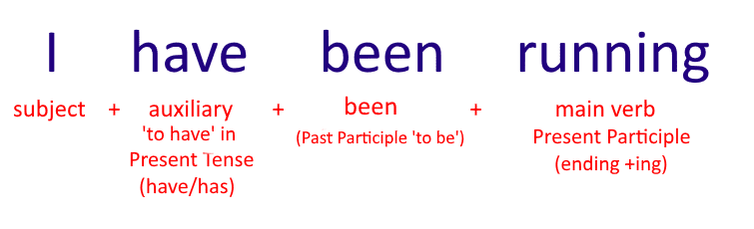
PRESENT perfect continuous

Slide 12
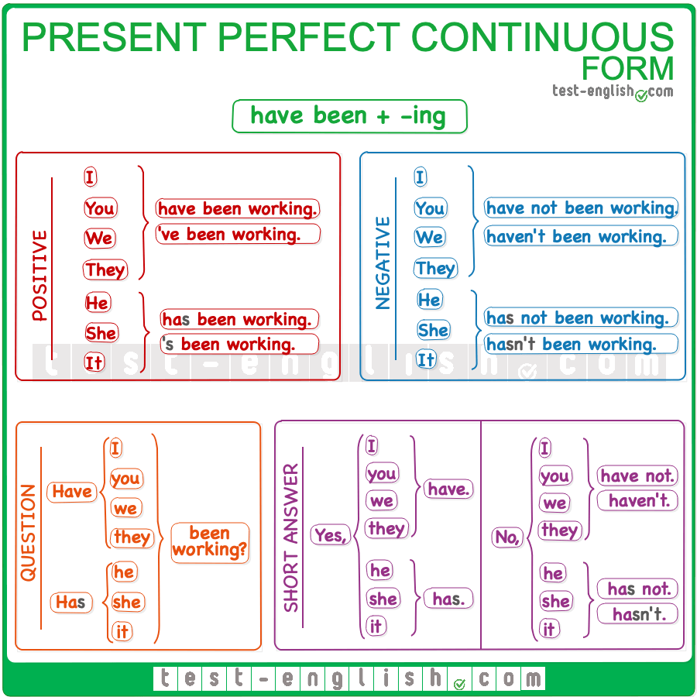
PRESENT perfect continuous

Slide 13


Slide 14
WEBLIOGRAPHY
For and since: https://elt.oup.com/student/englishfile/intermediate3/grammar/file02/nef_int_grammar02_b01?cc=ro&selLanguage=en
https://elt.oup.com/student/englishfile/intermediate3/grammar/file02/nef_int_grammar02_b02?cc=ro&selLanguage=en
https://elt.oup.com/student/englishfile/preint3/grammar/file04/grammar04_01a?cc=ro&selLanguage=en
https://elt.oup.com/student/englishfile/preint3/grammar/file04/grammar04_a02?cc=ro&selLanguage=en
Speaking cards: https://en.islcollective.com/english-esl-worksheets/grammar/present-perfect-or-past-simple-tense/have-you-ever-speaking-cards/82747 (ever practice)
Wordwall: https://wordwall.net/es-ar/community/present-perfect-or-past-since-and-for

Slide 15

THANK YOU FOR YOUR attention

